Slide 1
WV Faculty Salaries Proposal

Slide 2
Full Professor

Slide 3
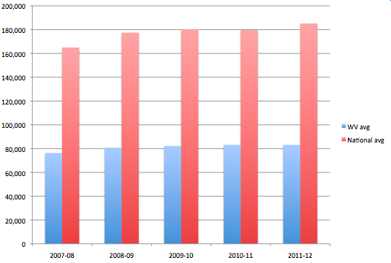
Full Professor

Slide 4
WV salaries

Slide 5
Table of Inflation Rates by Year
2005 3.4
2006 3.2
2007 2.8
2008 3.8
2009 -0.4
2010 1.6
2011 3.2 %

Slide 6
Historical US Inflation Rate
http://www.forecast-chart.com/forecast-inflation-rate.html
Annual Inflation Rates Last Month -1.8% Last Year . . . . . . . . . . . . . . . . . . . . 1.7% Last 5 Years 2.2% Last 10 Years . . . . . . . . . . . . . . . . . 2.5% Last 20 Years 2.5%
Thus typical is 2.5%

Slide 7
U.S. Inflation Rate Forecast Year Over Year Change in Consumer Price Index Percent http://www.forecasts.org/inflation.htm
Month Date Forecast %
0 Jun 2012 1.68
1 Jul 2012 1.5
2 Aug 2012 1.6
3 Sep 2012 1.8
4 Oct 2012 2.2
5 Nov 2012 2.5
6 Dec 2012 3.1
Updated Tuesday, July 17, 2012

