Slide 1
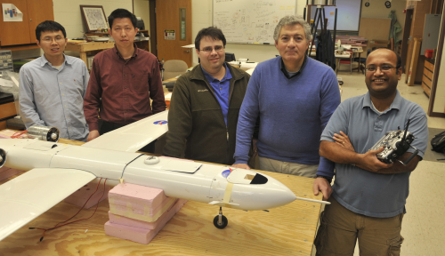
The Advisory Council of Faculty (ACF) “Creating a Culture for Student Success”
Marcello R. Napolitano, Benjamin M. Statler, College of Engineering and Mineral Resources, WVU
2012 West Virginia Professor of the Year, WV Merit Foundation

Slide 2
Higher Education Faculty Are Committed to Serve:
• our students through the development of quality academic programs and delivery of quality instruction;
• our institutions through instruction, professional development, research and scholarship, and direct service;
• our local communities through instruction and programs that bring economic growth, cultural and artistic events, business and educational partnerships, and research.

Slide 3
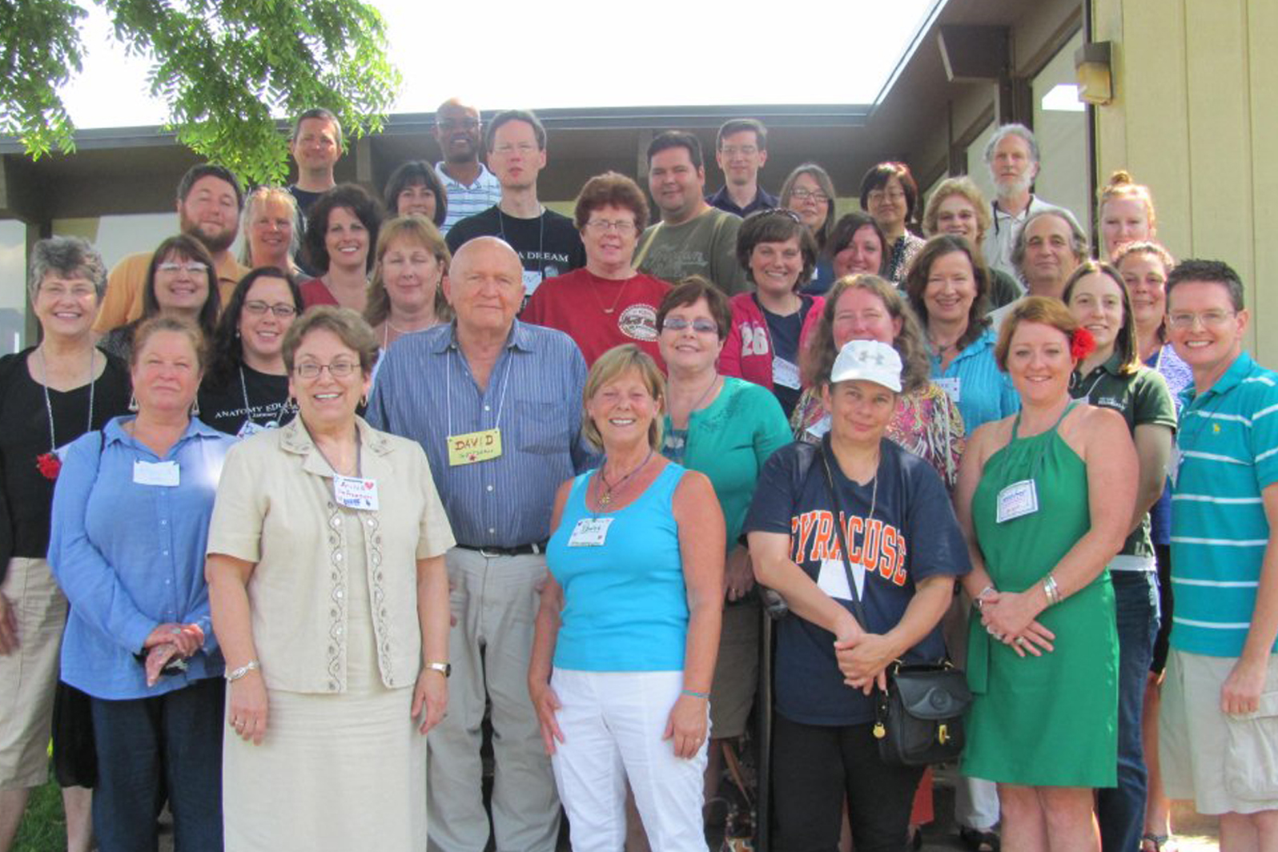
Twentieth Annual Great Teachers Seminar
North Bend State Park, June 2012

Slide 4
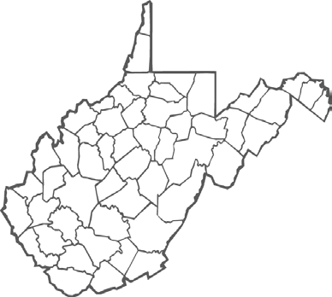
2012-13 WV Advisory Council of Faculty

Slide 5
Faculty Achievements
Curricular Reform:
Review & Revision of General Studies (Core Programs) Accomplished at Six Institutions: Shepherd University, New River CTC, Southern CTC, Bridgemont CTC, West Liberty University, WVU School of Osteopathic Medicine (2-yr curriculum);
Review & Revision of Majors Accomplished at Four Institutions: Shepherd University, WV Northern CTC, Potomac State College of WVU, West Liberty University;
Review and Revision of Curriculum in Progress at Twenty-three Institutions. —ACF Report

Slide 6
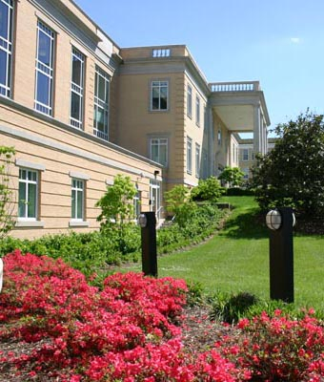
Achieving the SREB “No Time to Waste”: 120-Hr. Curriculum
Faculty Ownership
Administrative Support
3. A Plan

Slide 7
Increasing Retention and Reducing Hours to Graduation or Degree Completion (120/60 Hour SREB Curricular Recommendation)
Curricular Reform at One 4-Year Institution Required:
Reform of Majors & Minors:
• Standardizing requirements for majors within a range of 42-50 credits; (except where licensing requires additional hours);
• Reviewing all required minors (15-18 hr. minors);
• Re-visioning general education courses in majors and requiring first-year experiences, writing intensive courses in all majors, and capstones for all students.
General (Core) Education Reforms:
• Aligning requirements with AAC&U “LEAP” standards;
• Reducing requirements to 42 credits;
• Suggesting 30 credits first two years, 12 credits last two.
As a result, sixty-two students were able to graduate early, saving each student on average $4,300, for a total saving of $369,000!

Slide 8
WV Higher Education Faculty have accomplished the following:
♦ 52,478 Full-time Equivalent (FTE) Undergraduate Enrollment, a 6.6% 5-year increase;
♦ 3,190 Community College Degrees, a 10.9% 5-year increase;
♦ 8,412 Skill Set Certificates Awarded, a 34.2% 5-year increase;
♦ 2,949 Associate’s Degrees in 2010, a 42.7% 10-year increase;
♦ 8,583 Bachelor’s Degrees in 2010, a 15.5% 10-year increase;
♦ 2,694 Master’s Degrees in 2010, a 28.6% 10-year increase;
♦ 715 Doctor’s Degrees in Professional Practice
Awarded in 2010;
♦ 19,794 Adult Learners in Higher Education, a 7.7% 5-year increase;
♦ $208,881,286.00 in Research Grants in 2010.

Slide 9
And Yet . . .
”West Virginia ranks 15th among the 16 SREB states in faculty salaries, which is two places below its ranking a year earlier.” —HEPC/CCTCE 2011 “Report Card”
At the same time . . .
“Only 17% of WV students enrolled in the 9th grade will earn a two- or four-year college degree within ten years, [and] by 2018, 49% of the jobs in WV will require education and/or training beyond high school. ”
—May 2012 WV College Completion Task Force, “Educating West Virginia Is Everyone’s Business

Slide 10
The cost is high . . . but so are the stakes, so what can we do? What can the Legislature do to help us accomplish even more?

Slide 11
Provide a systematic funding mechanism for faculty salary raises and address the problem of salary compression in order to return West Virginia from 15th to 13th among SREB states;
2012-13 Higher Education Faculty Issues:
“Creating a Culture for Student Success”

Slide 12
♦Provide a systematic funding mechanism for
capital projects, deferred maintenance, and
Higher Education initiatives mandated by the
Legislature;
2012-13 Higher Education Faculty Issues:
“Creating a Culture for Student Success”

Slide 13
2012-13 Higher Education Faculty Issues:
“Creating a Culture for Student Success”
Amend code limiting 20%Tenured CTC faculty to 30%.

Slide 14
—providing a voice for 4,189 full-time and 1,961 part-time HEPC faculty and 558 full-time and 1,082 part-time CTCS faculty, in order to make West Virginia Higher Education better!

